Slide 1


Nykaa Analysis

Slide 2


Introduction to Nykaa
Overview
Business Model
Nykaa is one of India’s leading omnichannel lifestyle and beauty retailers, founded in 2012 by Falguni Nayar.
The brand revolutionized the Indian beauty industry by bringing global and domestic beauty, personal care, wellness, fashion, and lifestyle products to consumers.
Online platforms: Website & Mobile App
Offline: 150+ physical stores (Nykaa Luxe, Nykaa On Trend, Nykaa Kiosks)

Slide 3
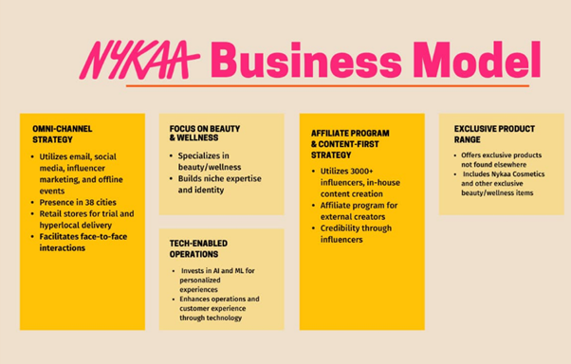

Slide 4
Beauty & personal care is nykaa’s core contributes the lion’s share of revenue and gmv. recent investor materials and filings show consistent growth in bpc and rising luxury brand additions.
Financial Trajectory:
Nykaa’s revenue has grown strongly in recent years (multi-year in the high-teens/30s range reported by analysts).
Market Position and Growth

Slide 5
Nykaa's Revenue Model
Profit After Tax
Revenue from Operations:
₹6,386 crore.
Further Information:
For the next fiscal year, FY25 (starting April 2024), Nykaa's revenue was reported to be ₹7,950 crore as of May 2025.
₹40 crore
Growth
24.1% year-on-year

Slide 6


Membership & Marketplace Revenue
Nykaa runs programs such as Nykaa Prive and Nykaa PRO for professionals. These programs drive retention, AOV and repeat purchase.
How membership drives revenue: members typically have higher retention, earlier access to launches and receive targeted promotions — increasing lifetime value.

Slide 7

Personalization Tactics
Targeted Emails: Sends personalized recommendations and promotions based on past purchases and interests.
Website/App Features: Uses data to display personalized product suggestions and relevant offers to users.
Influencer Marketing: Collaborates with influencers to promote trendy products to specific customer segments

Slide 8
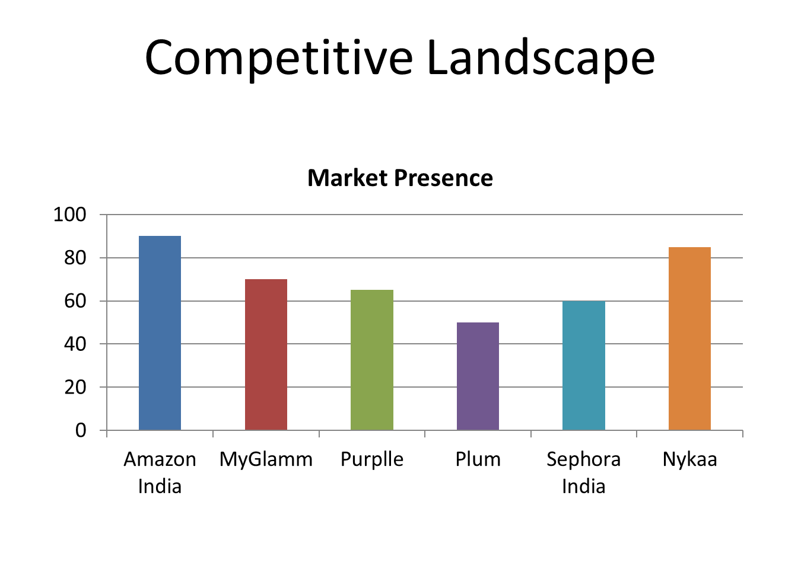

Slide 9
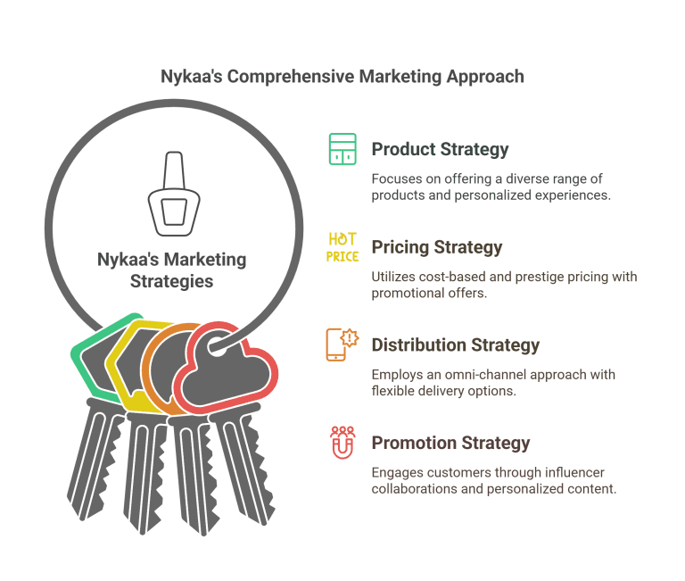

Slide 10
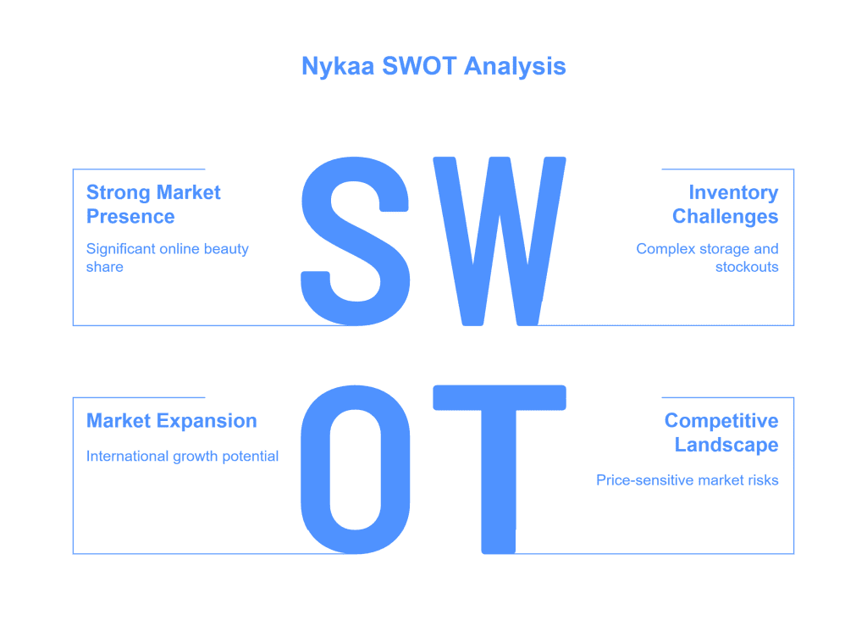

Slide 11
Strong brand recognition & trust in beauty authenticity.
Rapid expansion of premium/luxury assortments improving margins.
SWOT Analysis
Strengths

Slide 12
SWOT Analysis
Fashion vertical has historically underperformed vs BPC (seasonal / lower gross margins).
Heavy competition on price and fulfilment from other e-commerce players.
Weaknesses

Slide 13
Expand subscription/membership monetization and salons, professionals.
International expansion / cross-border luxury sourcing and private label export potential. (Strategic opportunity.)
SWOT Analysis
Opportunities

Slide 14
Intense competition from Amazon, Flipkart and specialist retailers.
Supply chain / inventory risk if premium brand relationships change.
SWOT Analysis
Threats

Slide 15
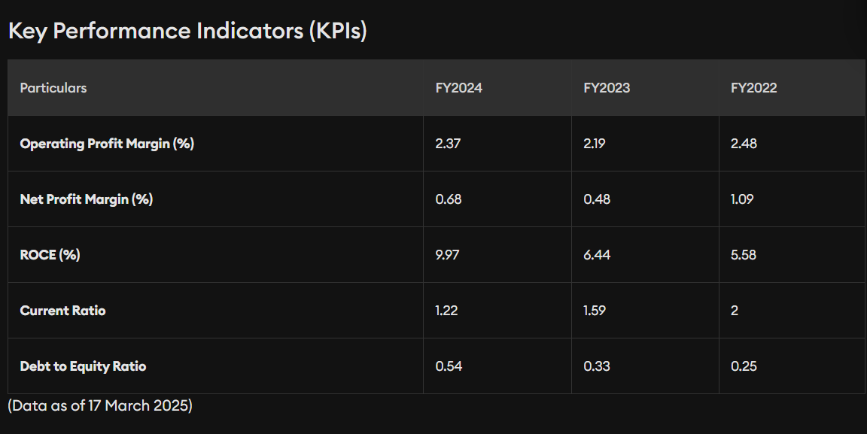

Slide 16
Key Takeaways / Recommendations
Focus on international expansion
Strengthen private label portfolio
Leverage AR & AI tech for better customer engagement
Increase marketing in Tier-2 & Tier-3 cities

Slide 17


References / Sources
Nykaa official website
Industry reports (RedSeer, Statista, IBEF)
News articles (ET, Business Today, Livemint)
https://www.pocketful.in/blog/nykaa-case-study-swot-analysis-and-marketing-strategy

